Slide 1






































Slide 2



















Slide 3
HISTORY OF MACHINE LEARNING
1950s – Turing proposes thinking machines
1957 – Perceptron: First learning algorithm born
1980s – Neural nets revived with backpropagation
1997 – Deep Blue defeats world chess champion
2012 – Deep learning wins image competitions
Now – ML powers AI in everything

Slide 4
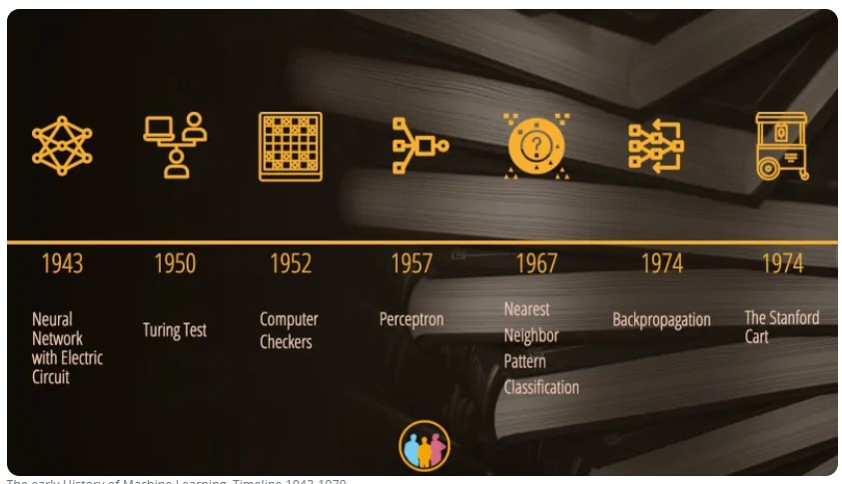

Slide 5



























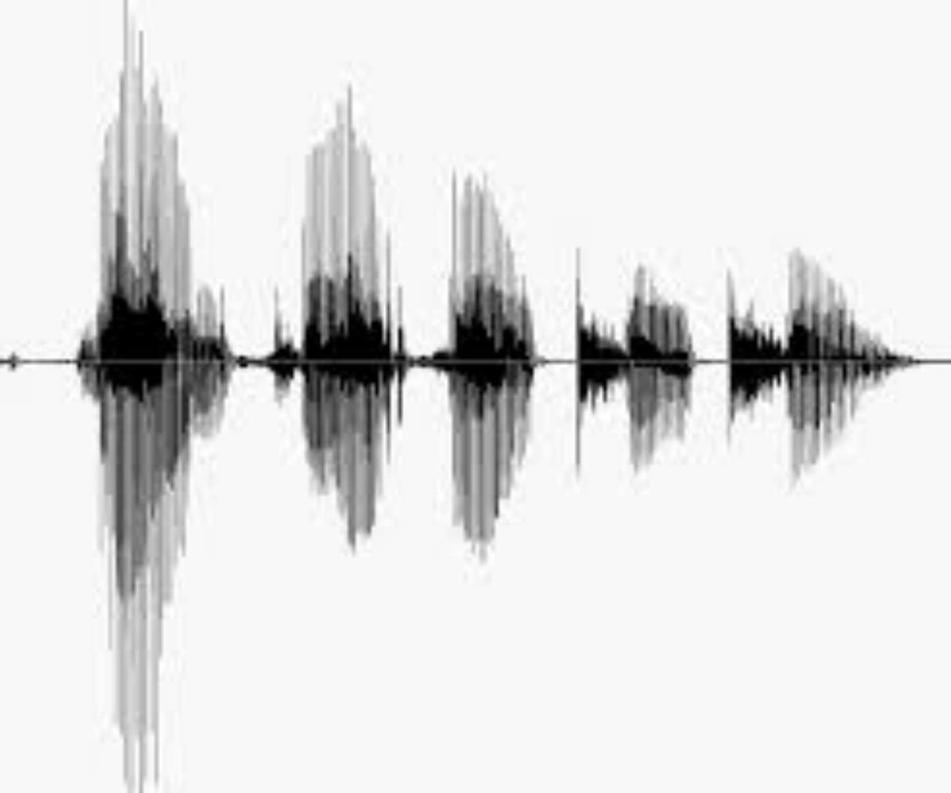
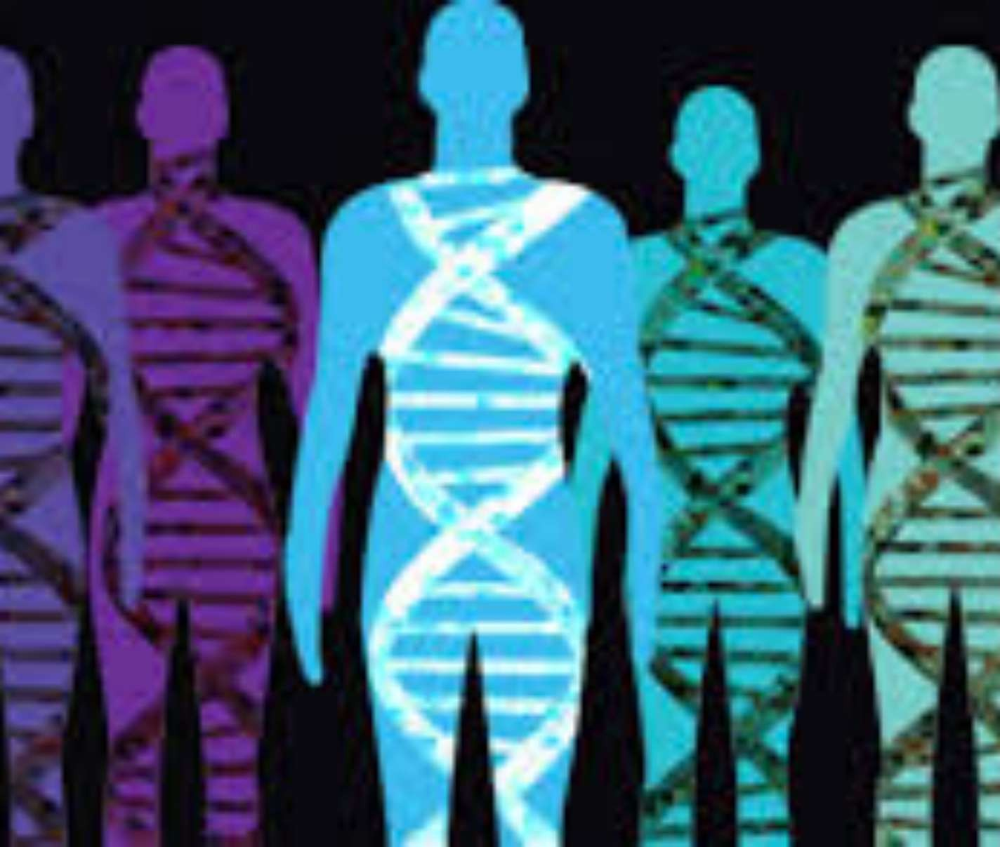
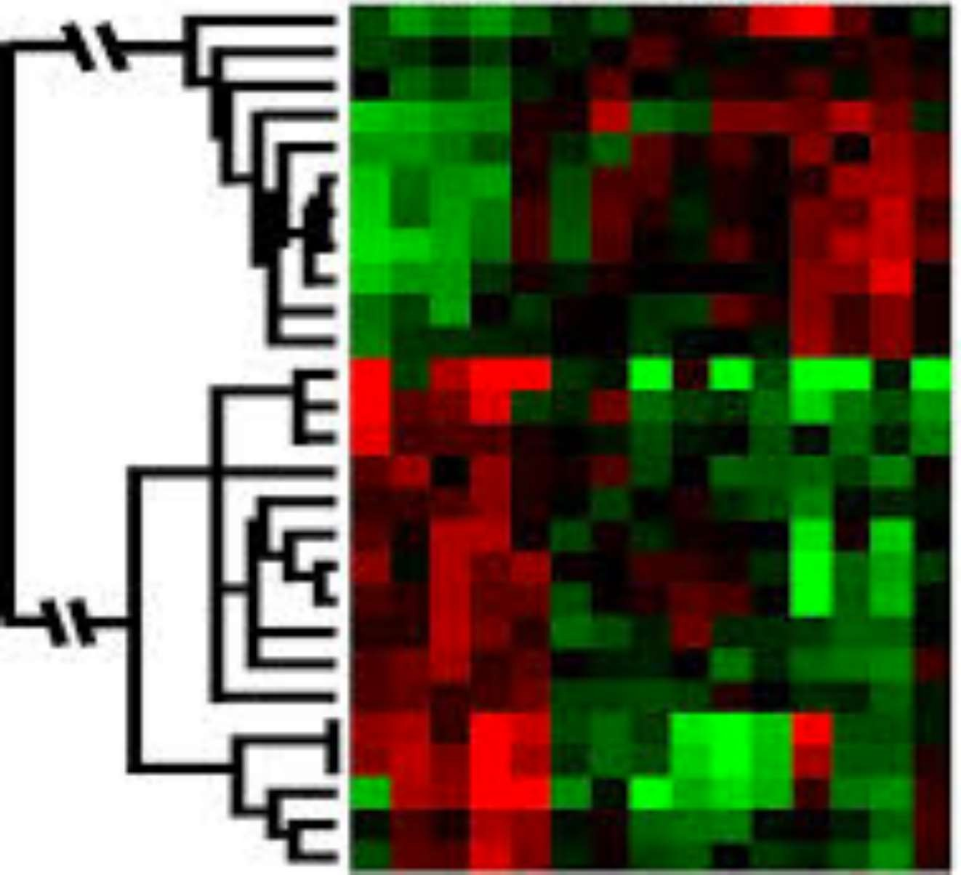











Slide 6




























































Slide 7
























Slide 8
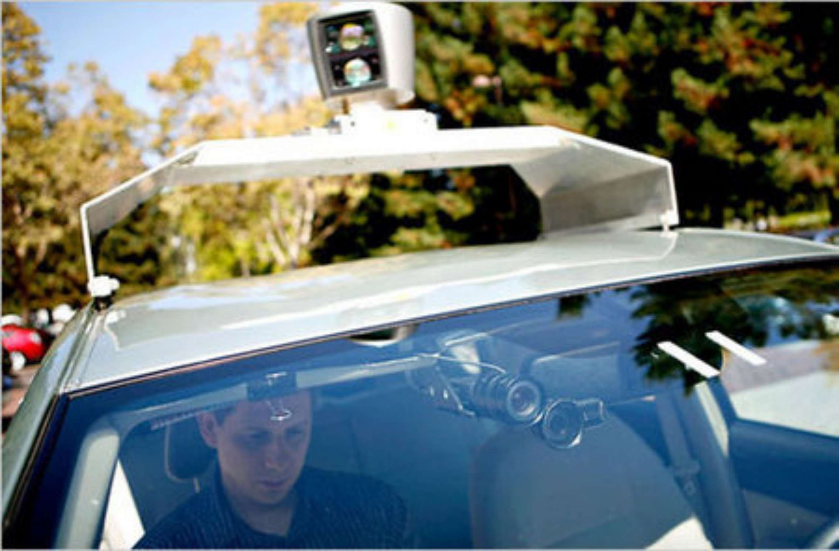
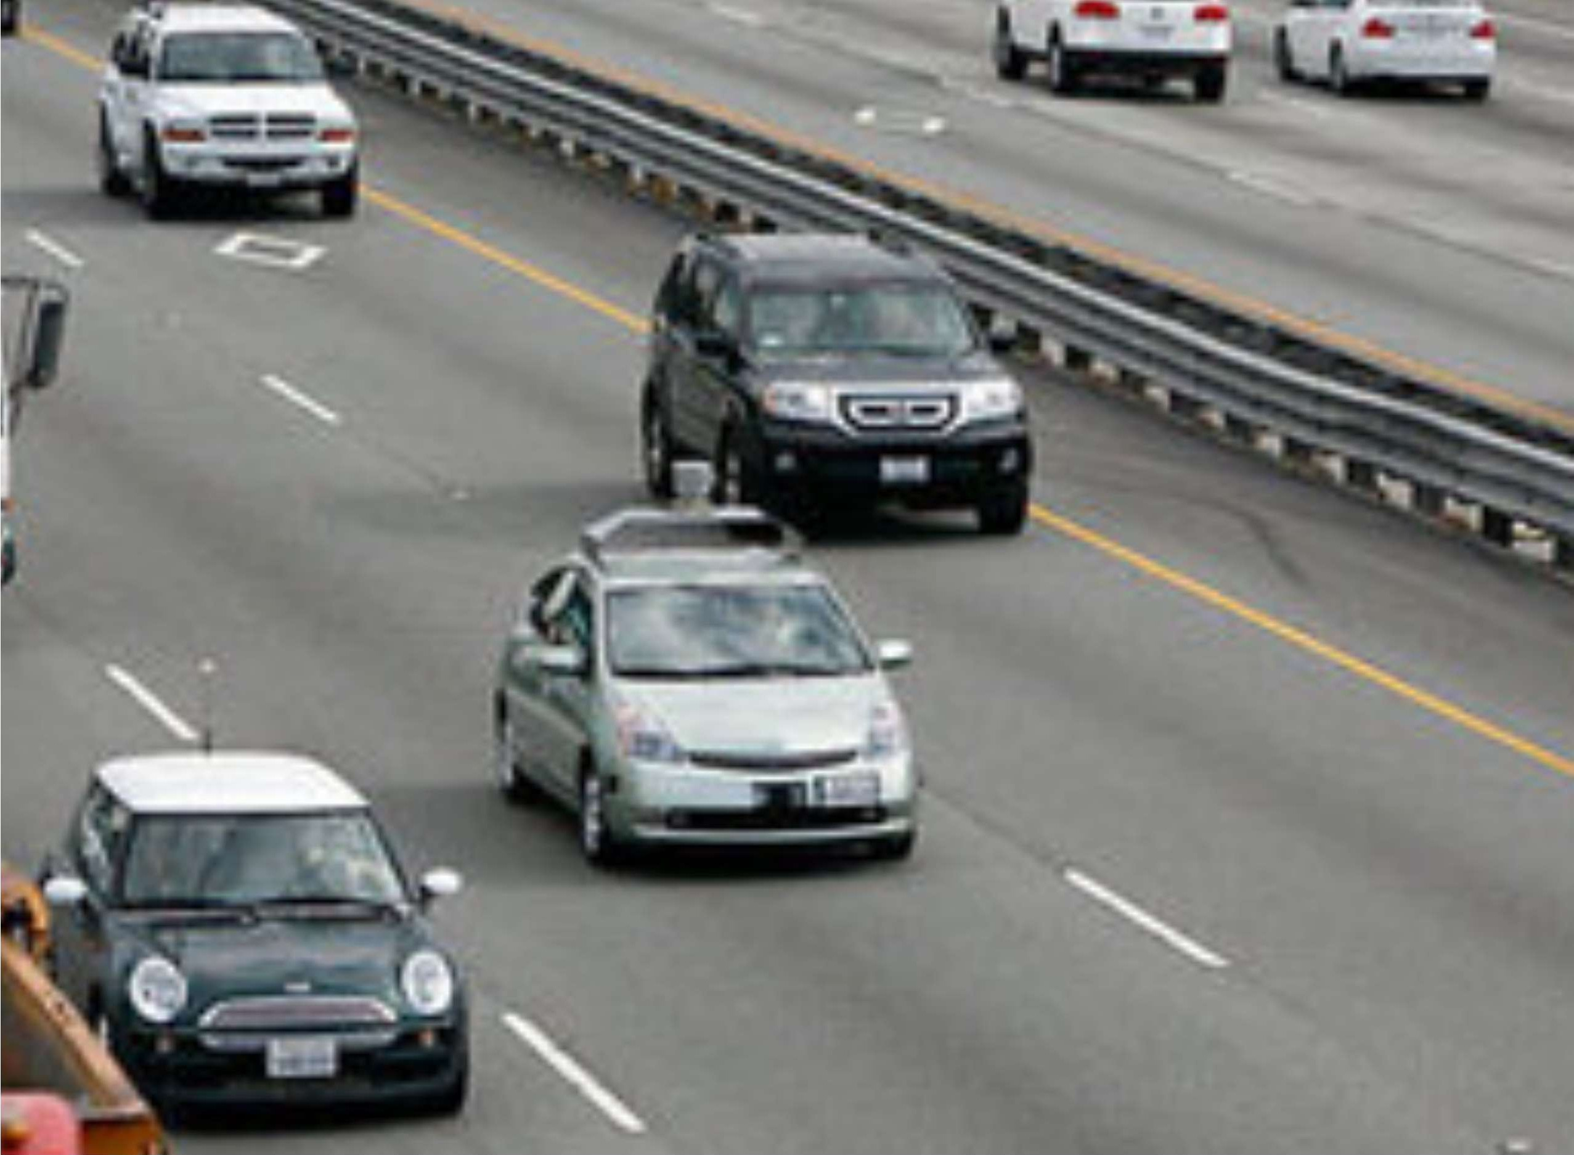




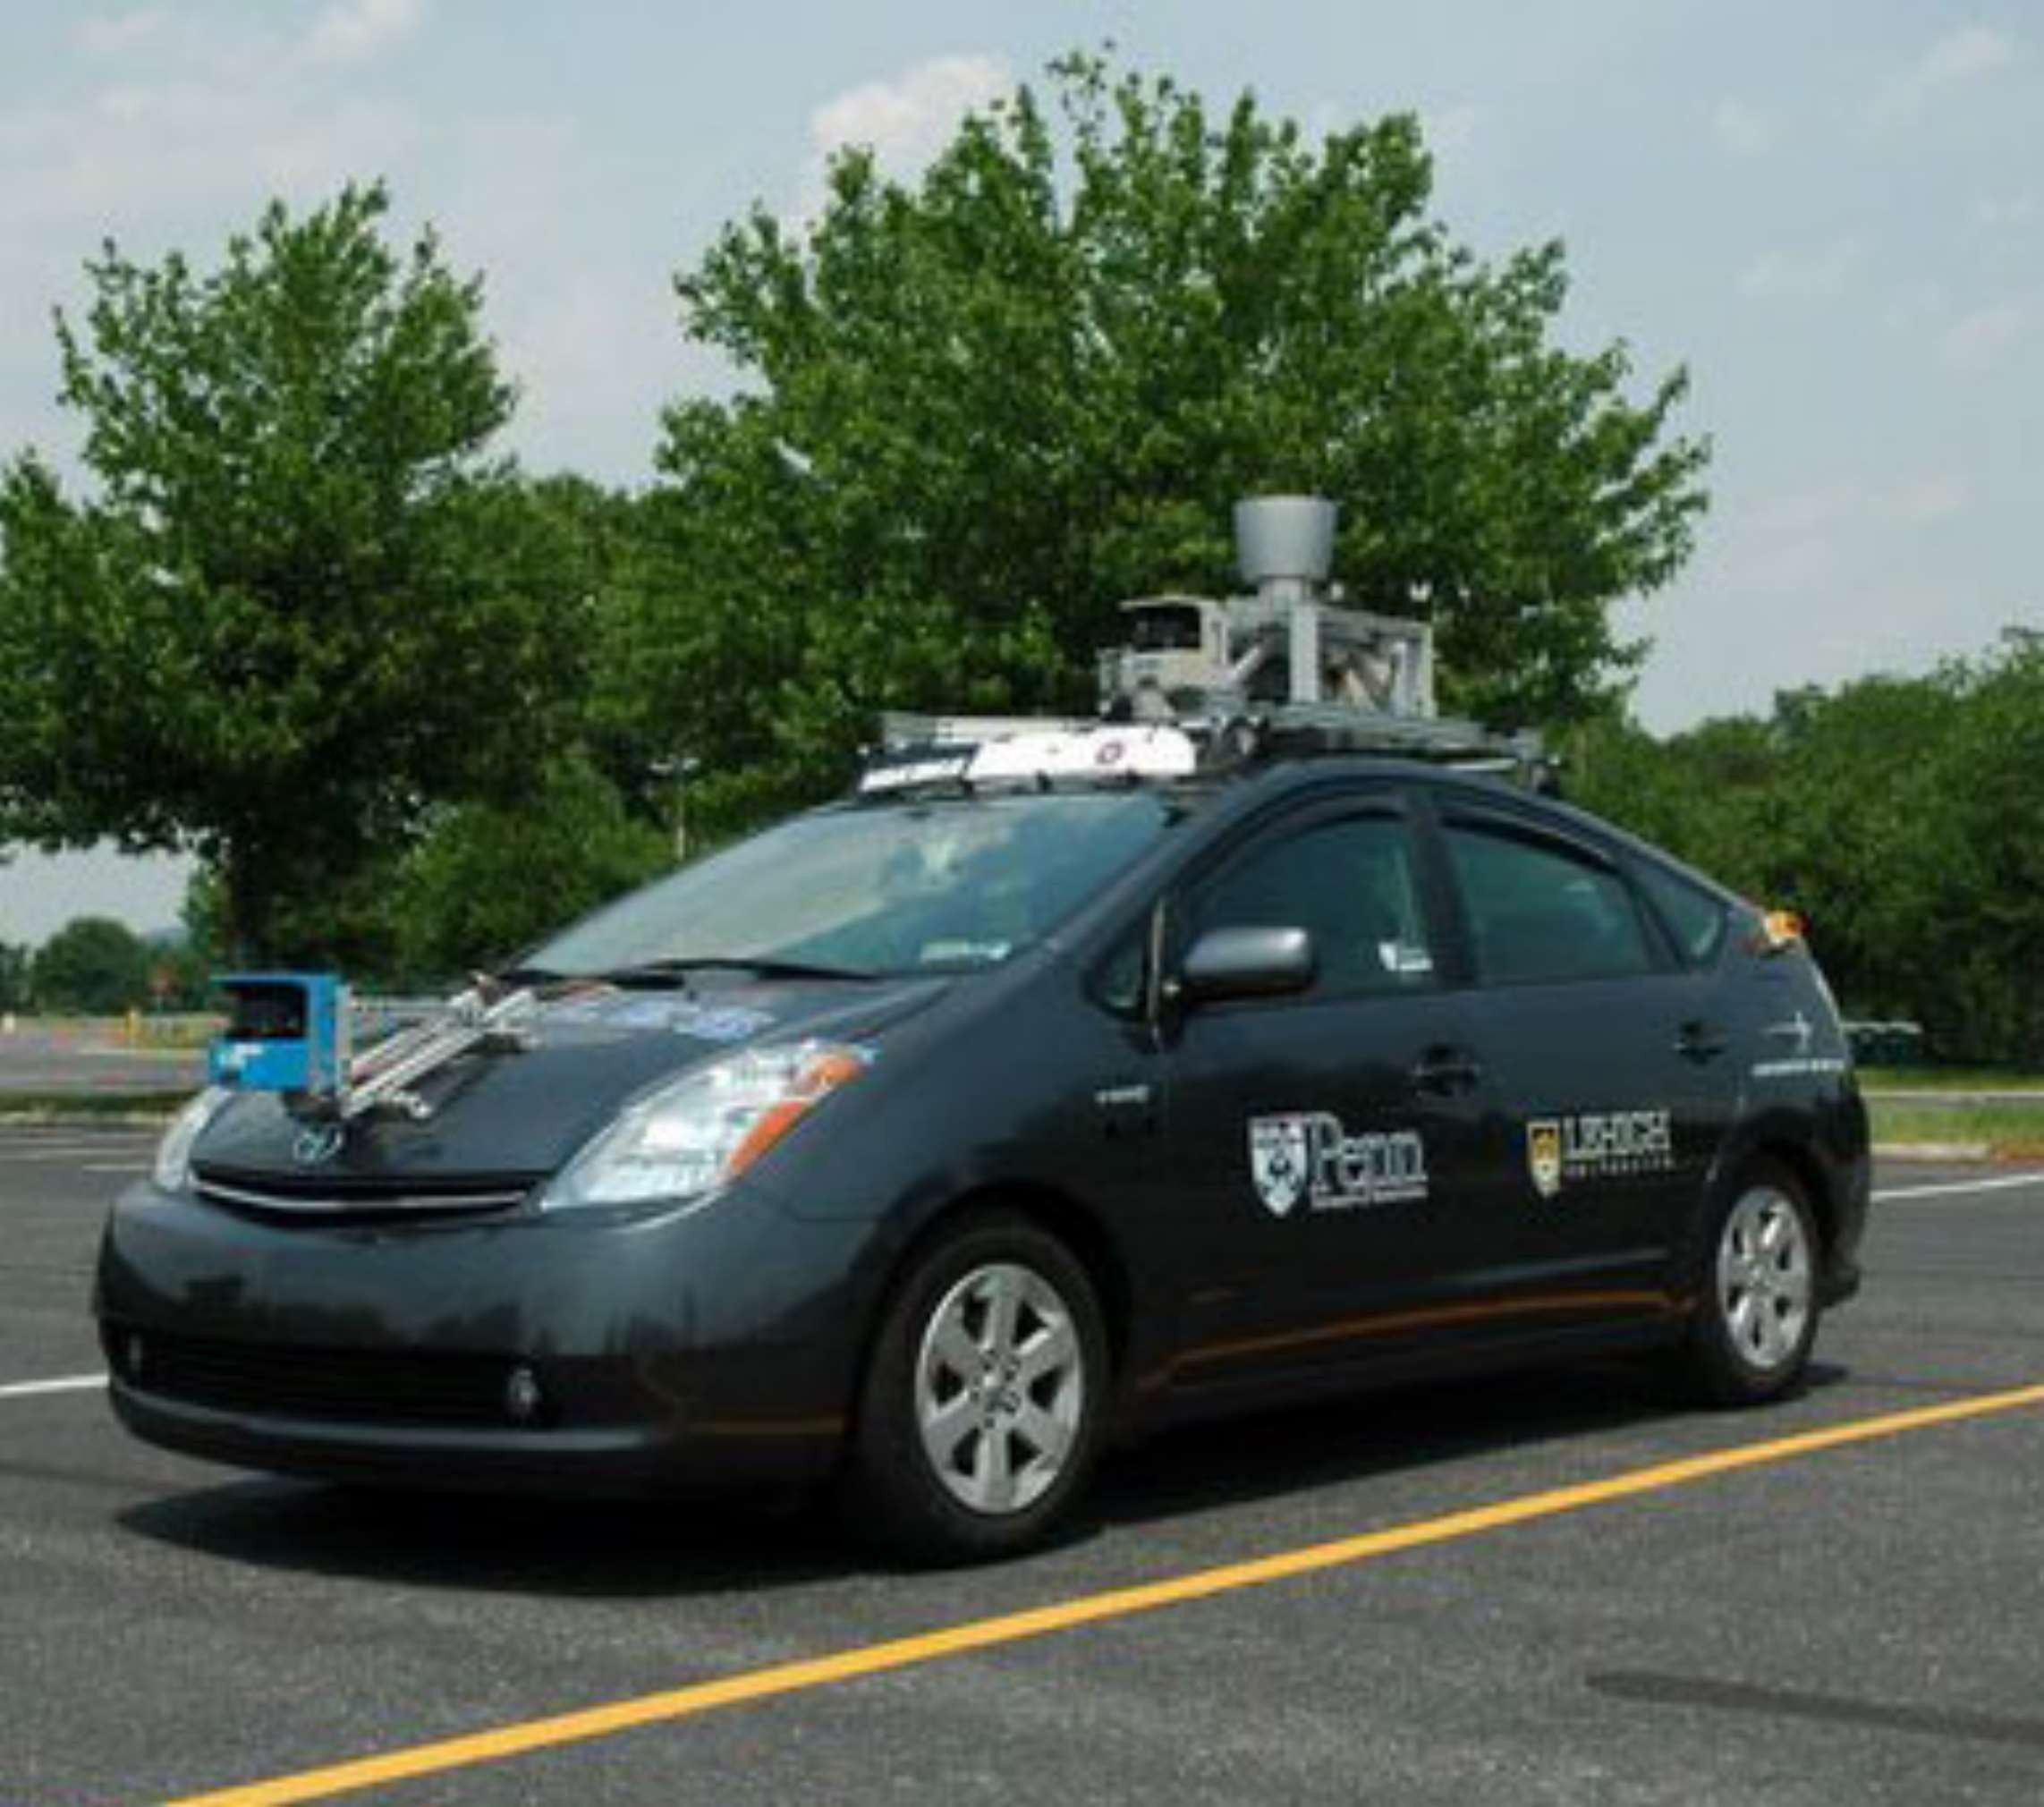


















Slide 9
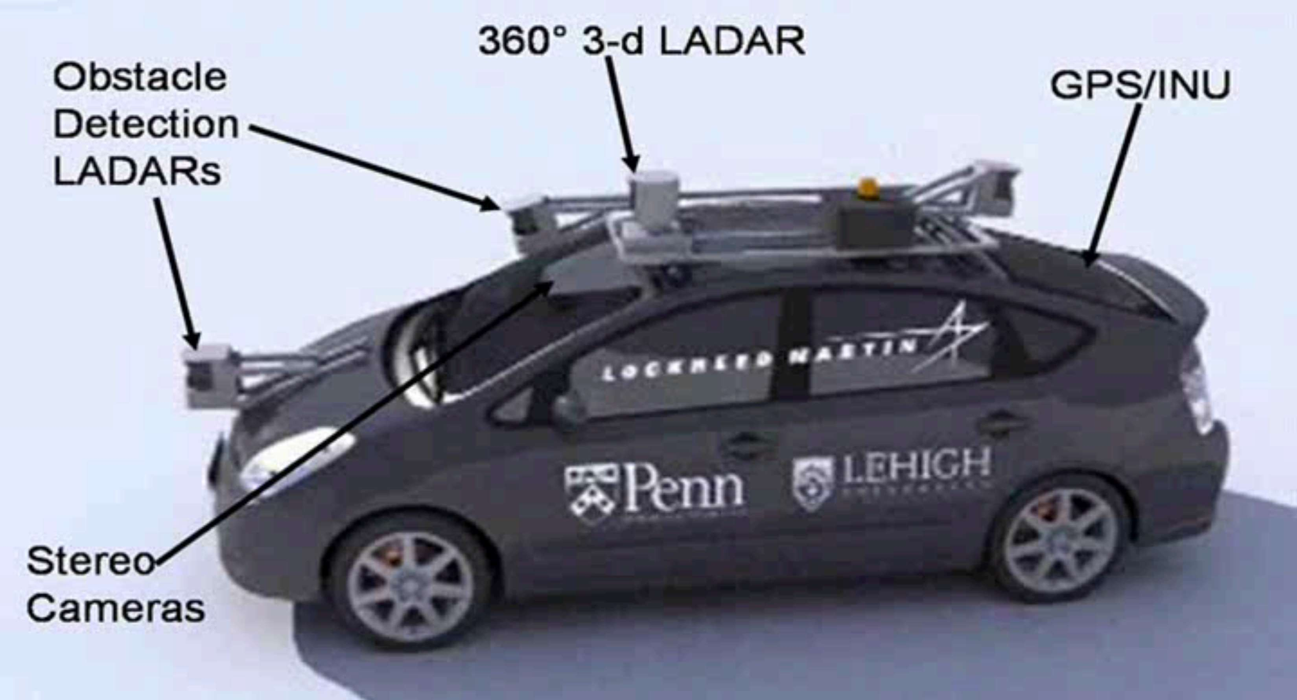

Slide 10
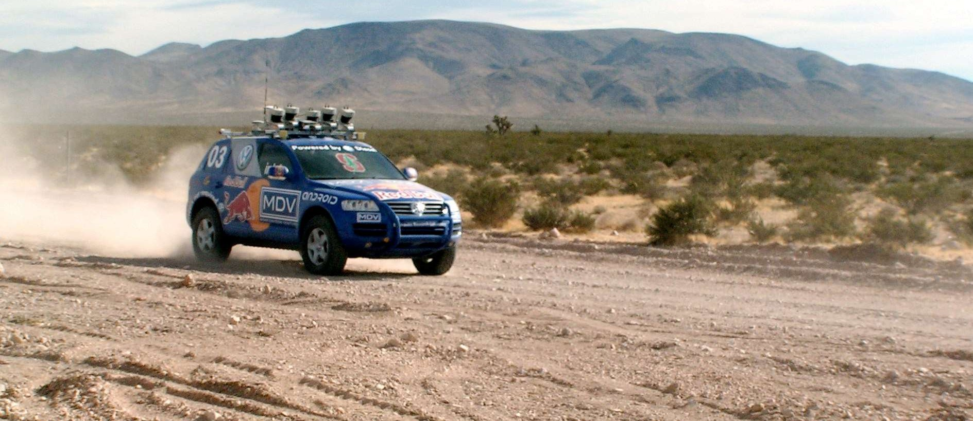
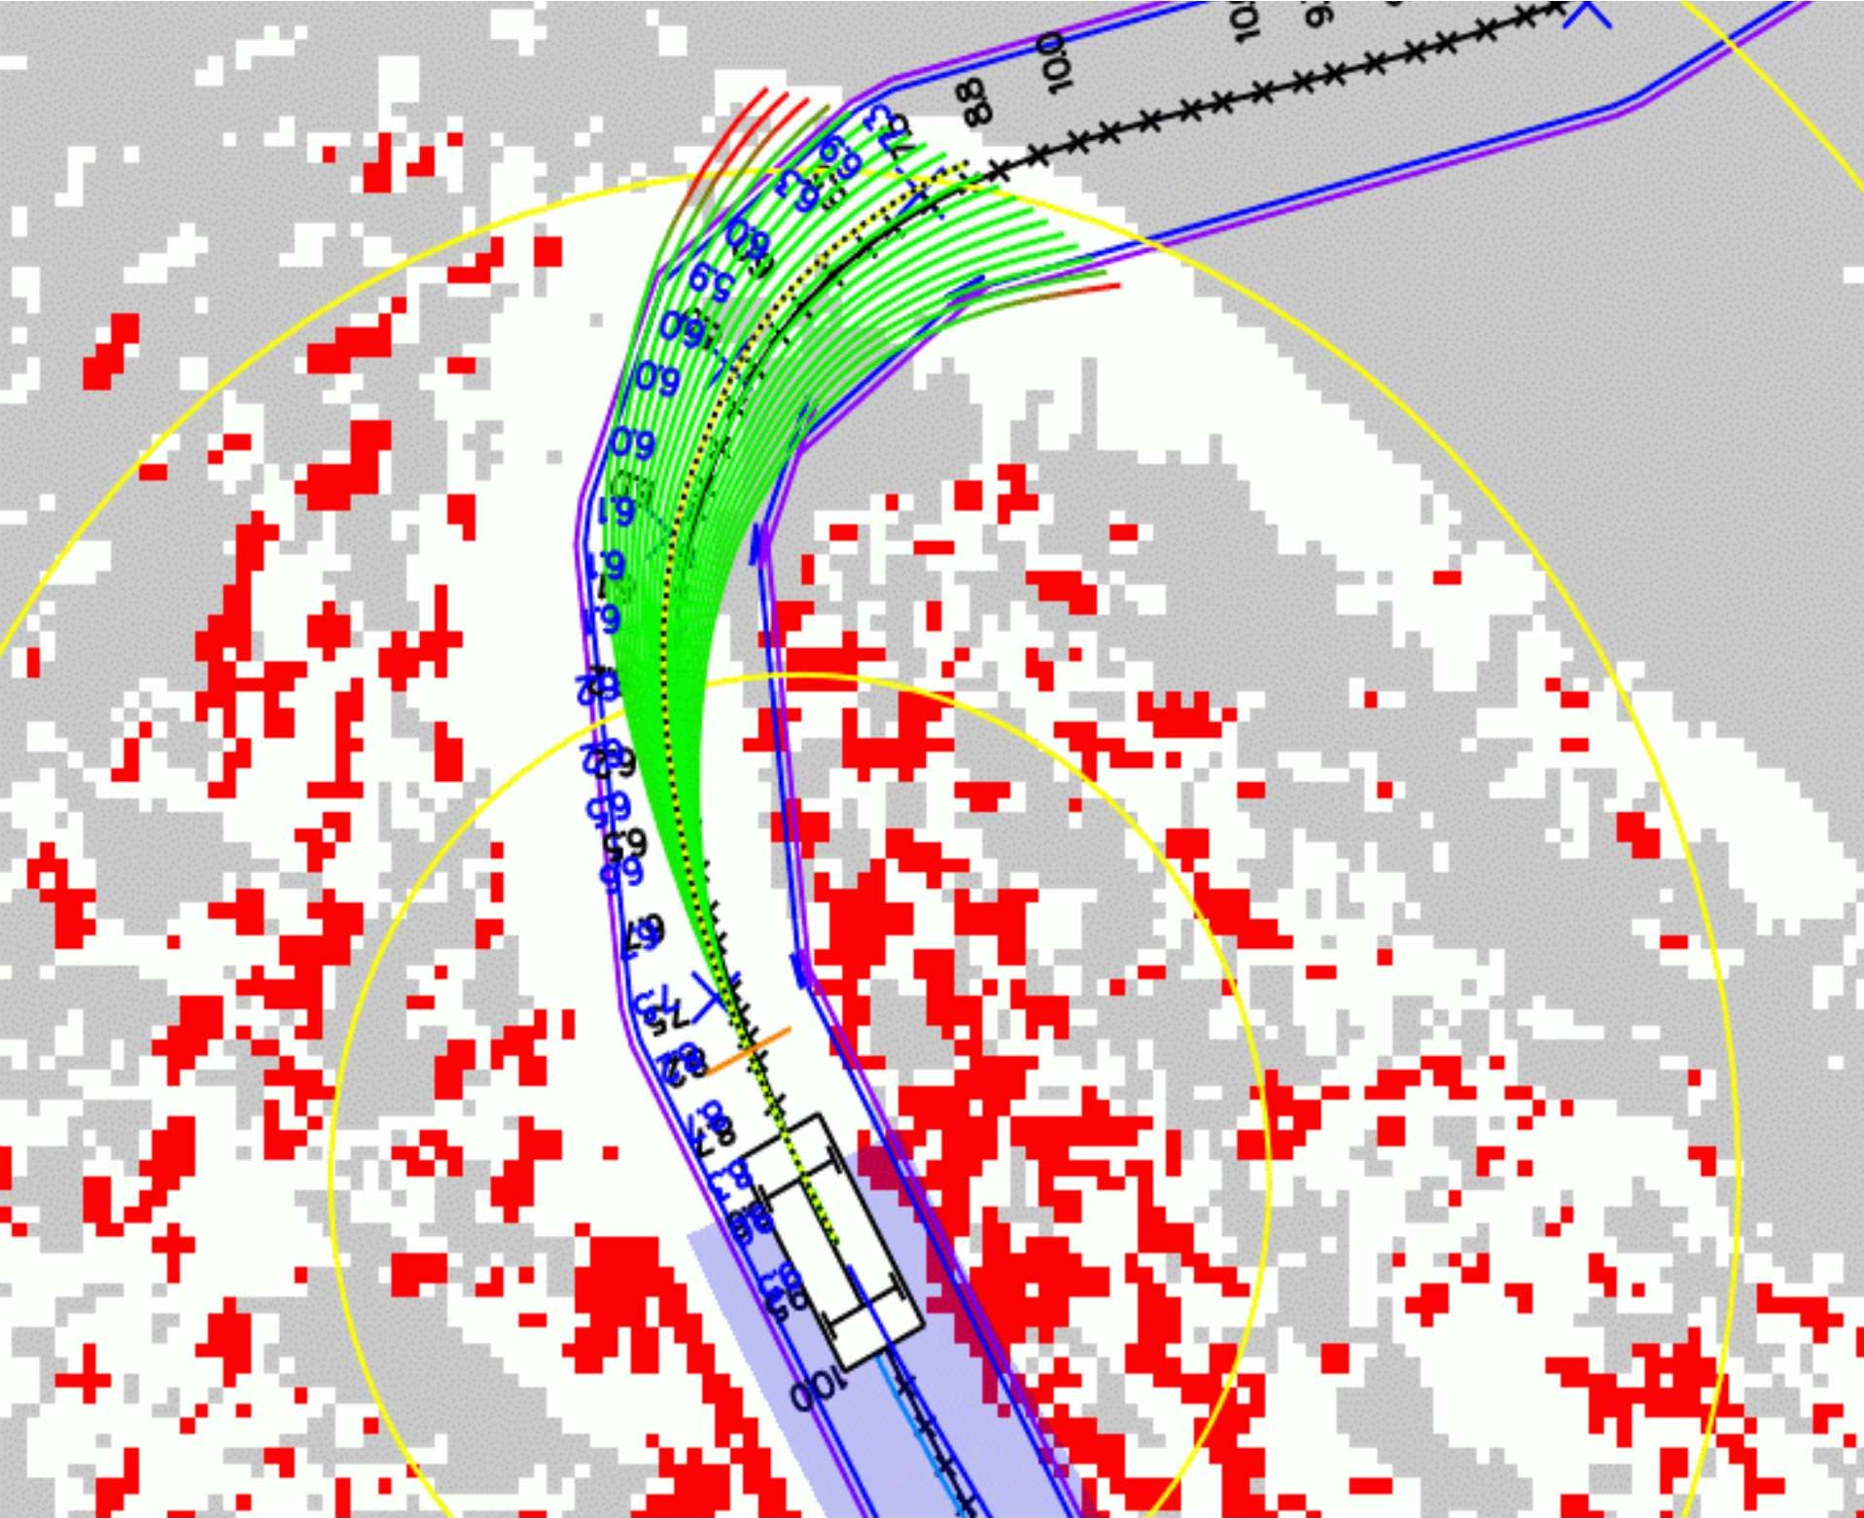






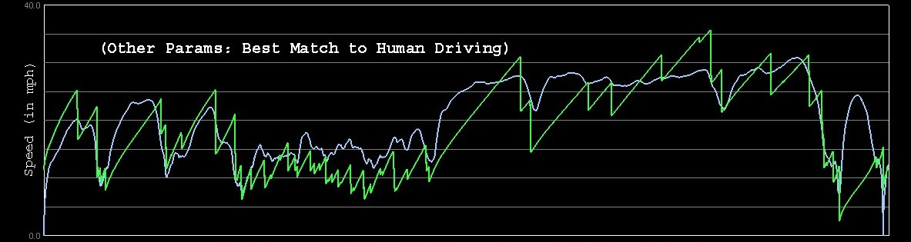










Slide 11








































Slide 12

























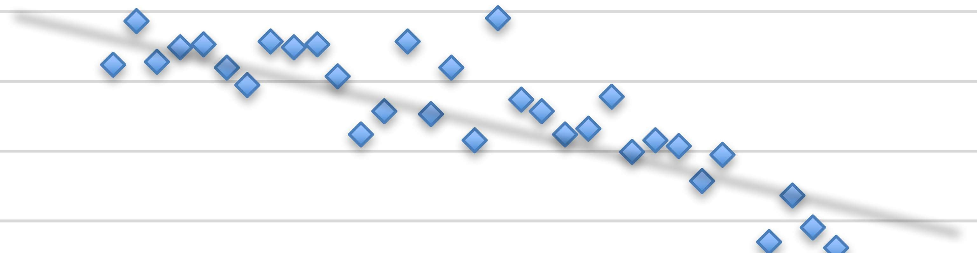












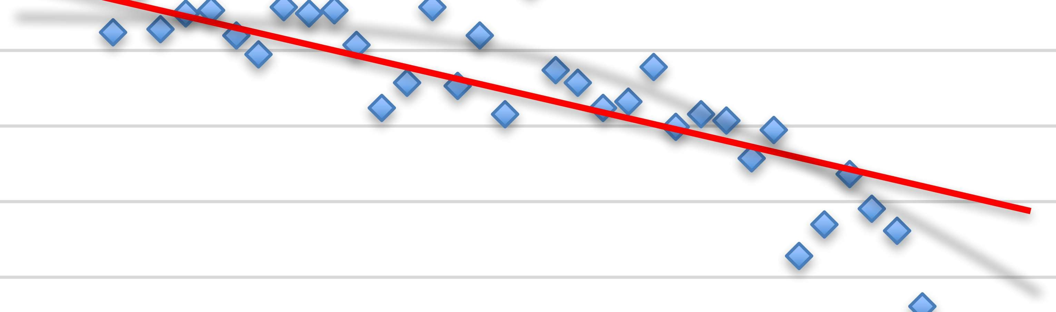























































Slide 13


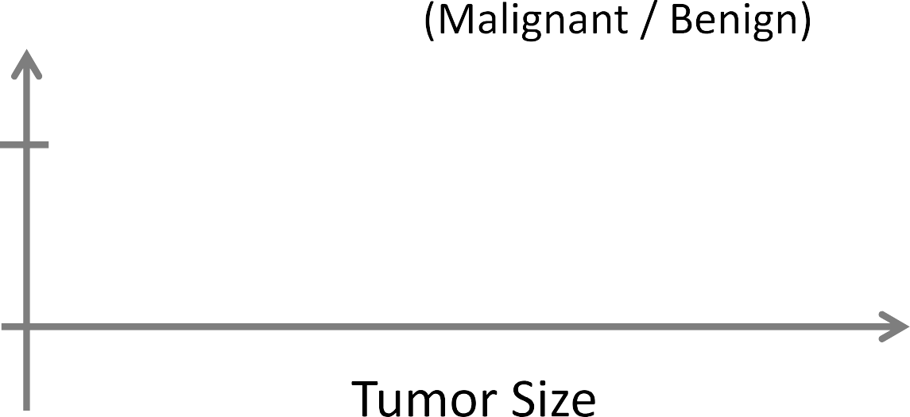













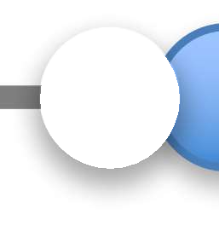












Slide 14







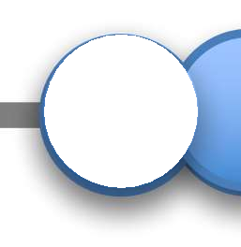
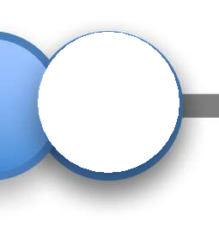












Slide 15



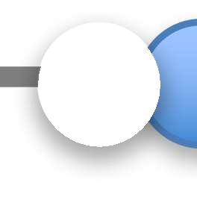









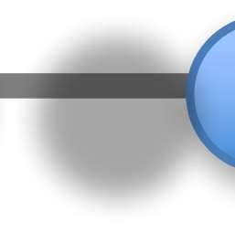









Slide 16











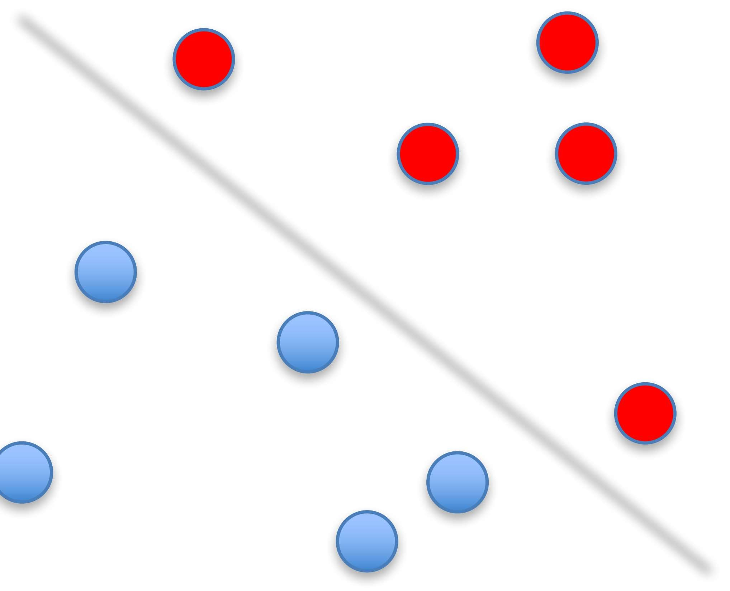
































Slide 17





































































Slide 18






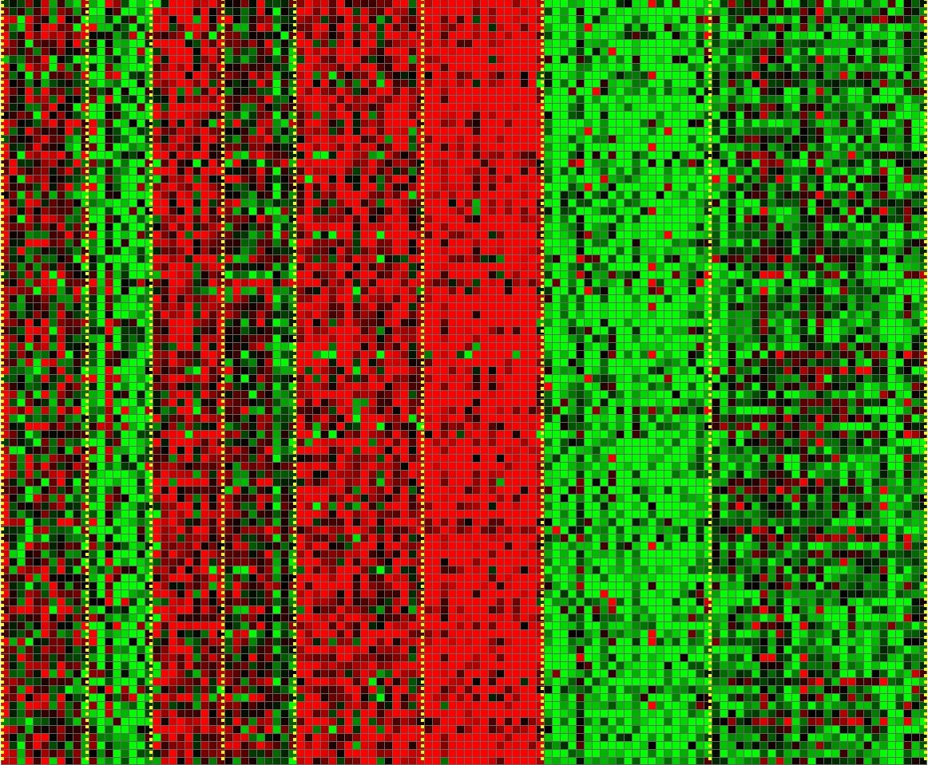



Slide 19


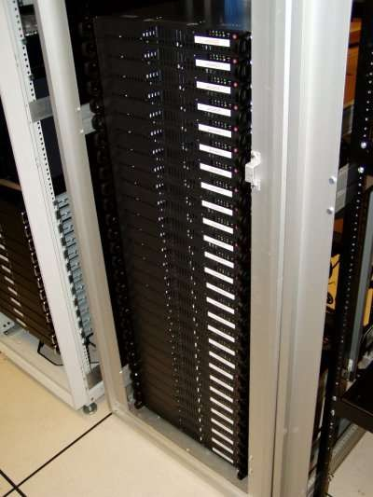
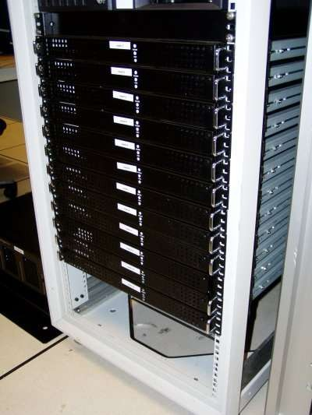














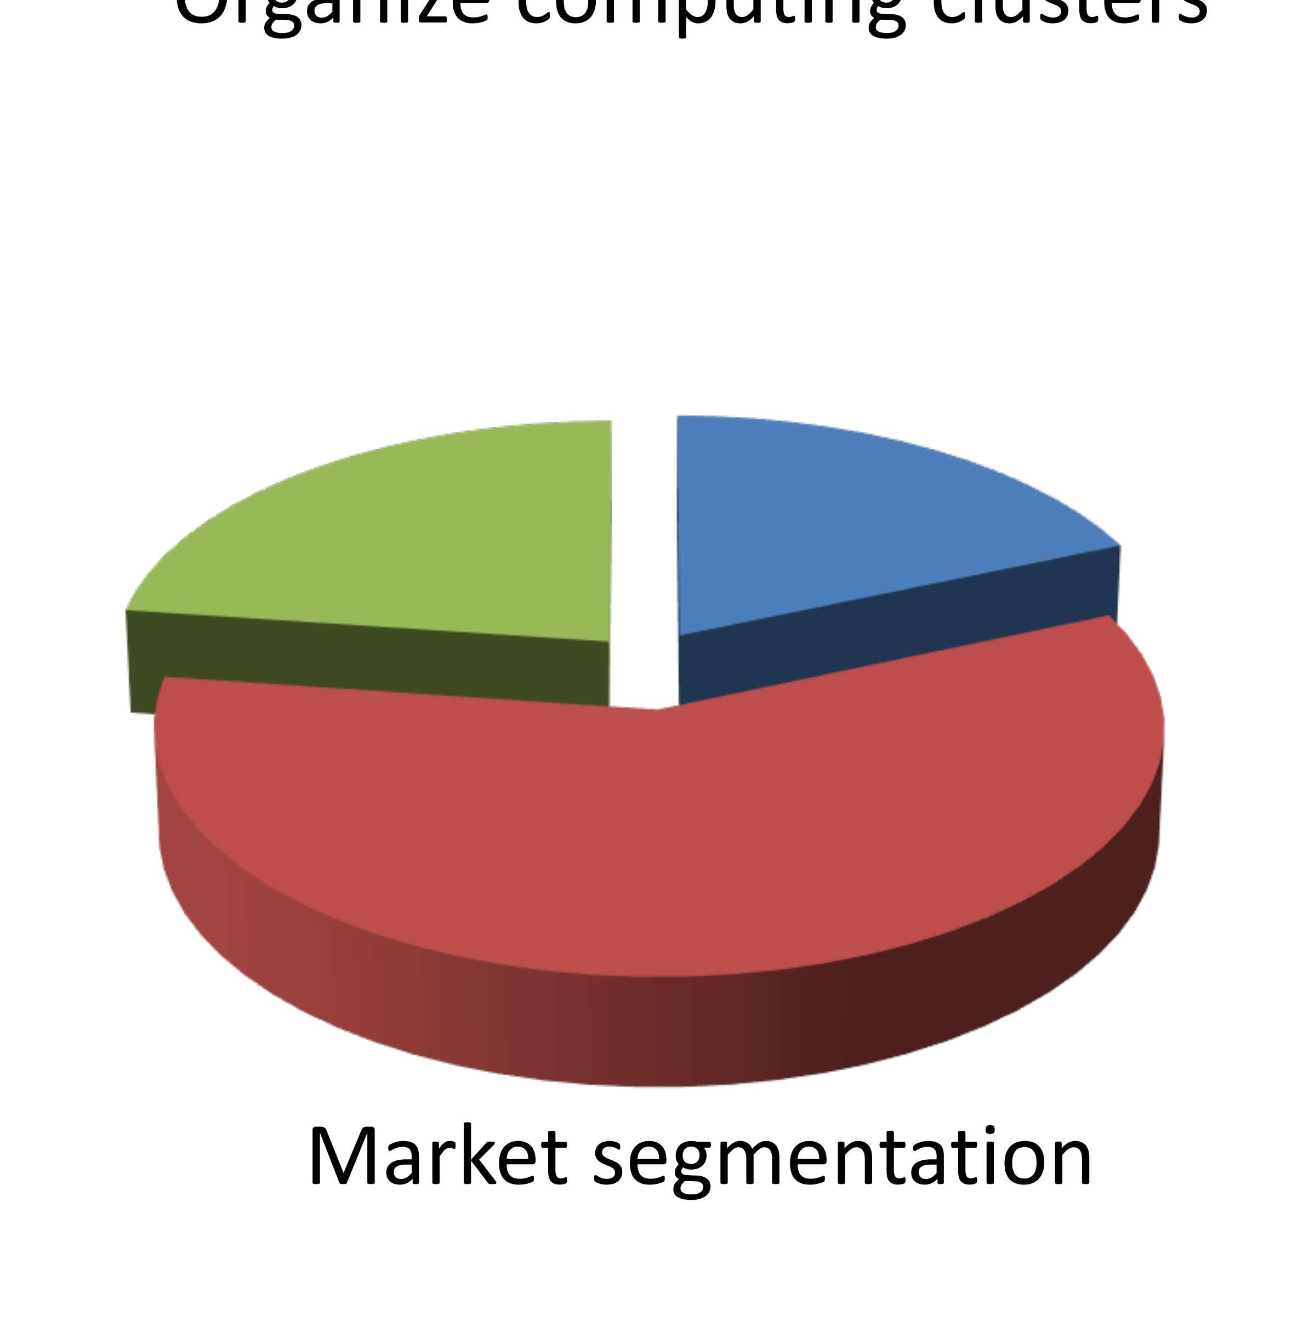



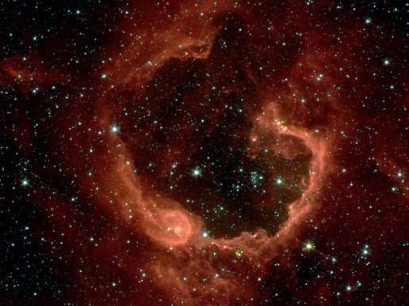


















Slide 20
























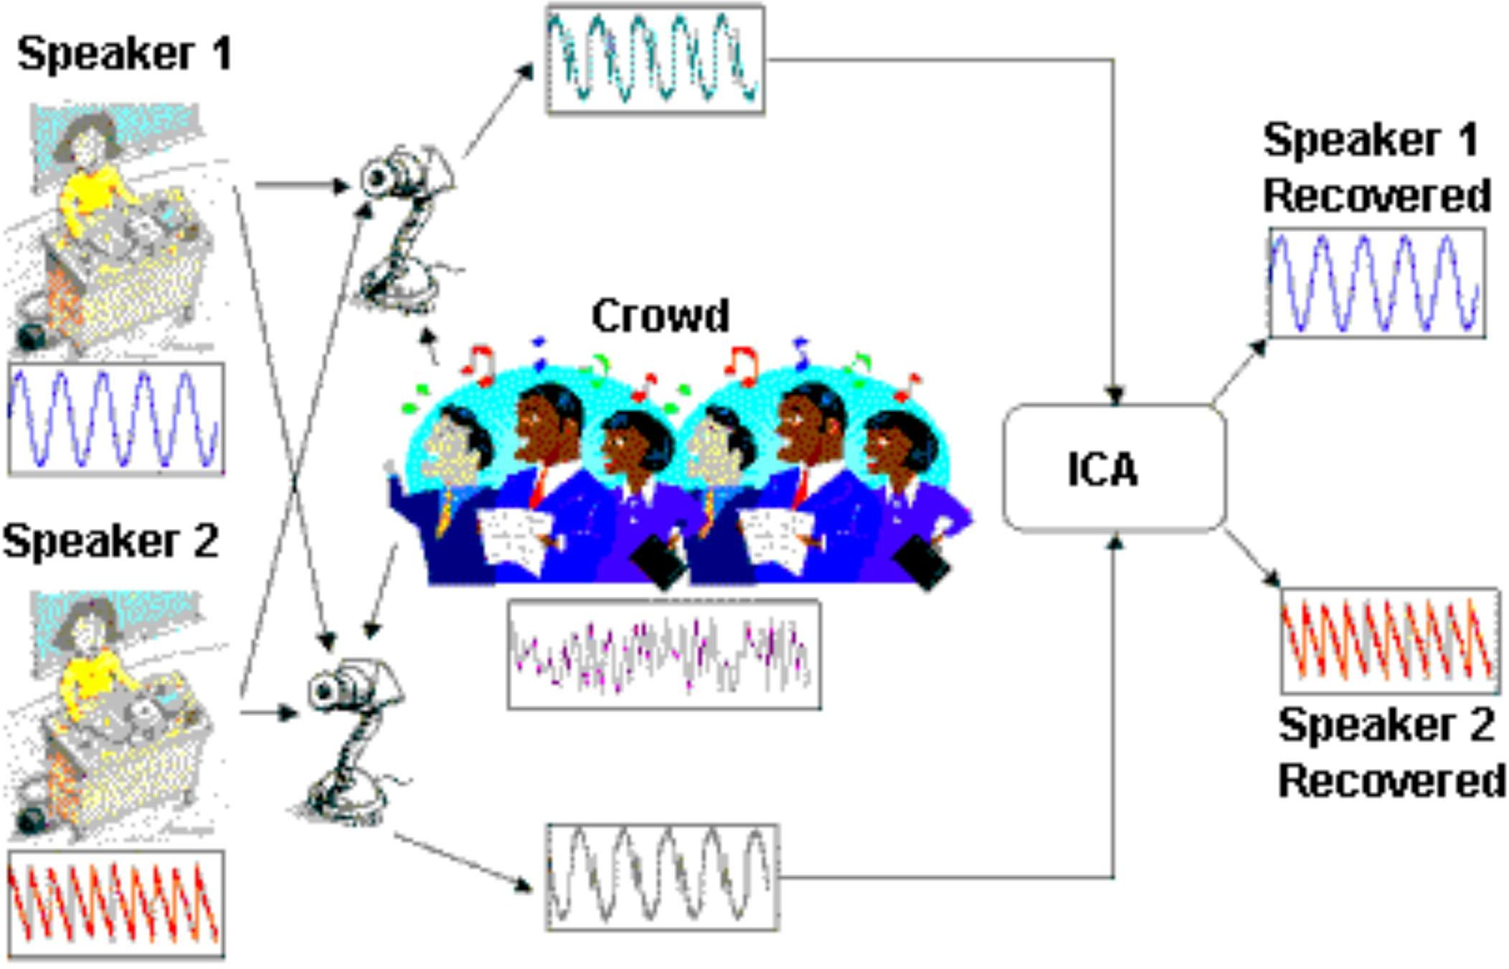




Slide 21








Slide 22

















































Slide 23










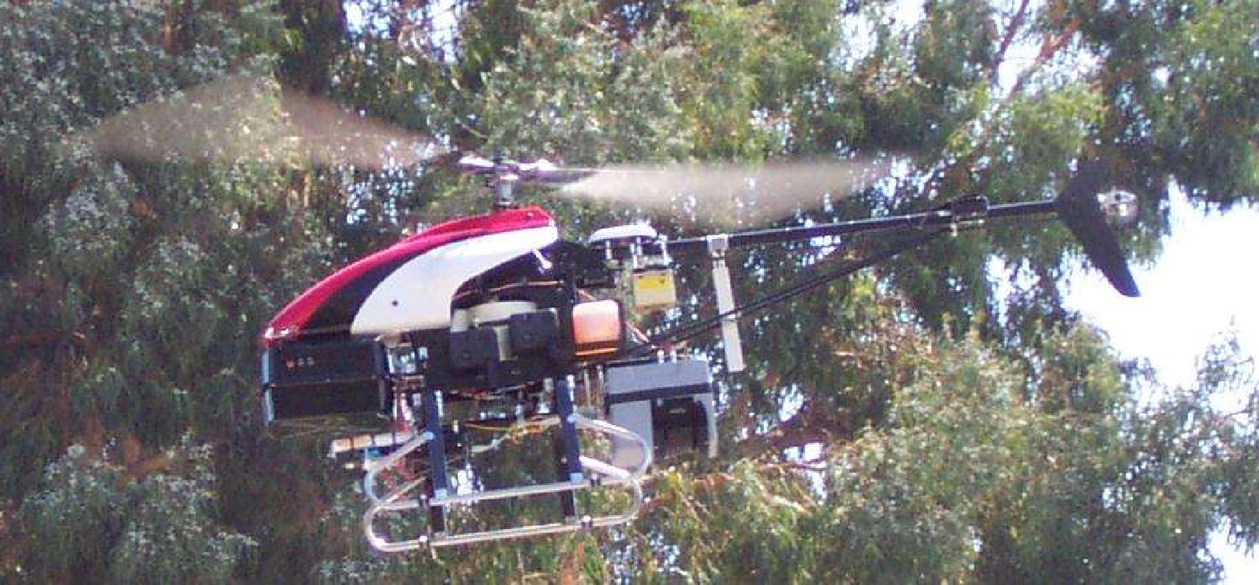




Slide 24
FUTURE AND SCOPE OF MACHINE LEARNING
Personalized AI in healthcare and education
Autonomous vehicles becoming everyday reality
Smarter assistants across all digital platforms
AI ethics guiding future tech development
Job evolution not just job loss
Global impact in climate, safety, innovation

Slide 25
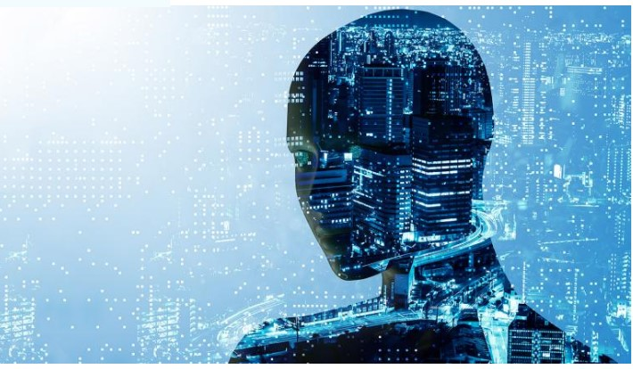

Slide 26
PROS AND CONS OF MACHINE LEARNING
✅ Pros
Learns from data automatically
Improves with more experience
Handles complex problems efficiently
Enables automation and personalization
❌ Cons
Requires large, clean datasets
Can be biased or unfair
Hard to interpret decisions
High computation and training cost

